Slide 1

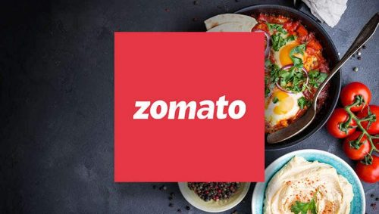
© All rights reserved by Fireblaze Technologies Pvt. Ltd.

Slide 2
Data Analysis of Zomato
Vaishali Kadam
© All rights reserved by Fireblaze Technologies Pvt. Ltd.

Slide 3
Problem Statement
Zomato is an Indian multinational restaurant aggregator and food delivery company .
Zomato is one of the most comprehensive and user-friendly apps for finding nearby restaurants and cafés to dine in or to order food online. It also gives menus, reviews, and ratings to acquire factual information on eateries.
Zomato Limited is an online restaurant guide and food ordering platform. It offered comprehensive details on more than 1.4 million establishments in 23 countries. There were restaurant names, menu items, pricing, reviews, and other information.
It has evolved into an internet platform for meal delivery over the years. Zomato's tagline – “Never have a bad meal”. It serves as a comprehensive encyclopedia of restaurants, replete with ratings, average pricing, menus, and reviews.
Lets take the data of Zomato Worldwide and analyze it and give proper information to the customer so that the customer enjoy their meals without any interruption.
In the data provide we need to identify the low or under rated restaurant and need to update the restaurant.
Find out the cheapest restaurant belong to the city and its country similarly the most expensive restaurant belong to the city and country.
The distribution of restaurant over the various countries such as India , USA, UAE and few other countries.
Here we get the data and with respect to that data we analyze it and further which is in major part of data …we going on that path..
© All rights reserved by Fireblaze Technologies Pvt. Ltd.

Slide 4
Proposed Solution
User who try to find local restaurants of various cuisines. Restaurant who want their name to reached targeted audience.
Customer Preferring Home Delivery.
Database Companies
Market Research Companies
One stop shop for dines and offers restaurants a way to differentiate them
Bridge the gap between Customers and Restaurants by efficient technology by reduce delivery time .
Rating based price model for foods
Provide local restaurants and hotels search services.
Collect data for food menus , contacts and relevant information to users
Large dataset present across cities.
Presence across 15 countries.
© All rights reserved by Fireblaze Technologies Pvt. Ltd.

Slide 5
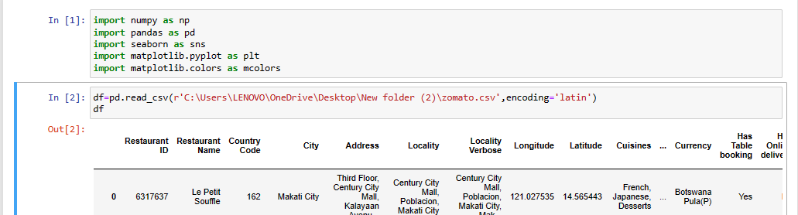
Descriptive Analysis and loading of data
First we have to load all the Library which we are needed and then load the Data through csv file…
After Loading the data we have to find more information about the columns which we are dealing with…..
© All rights reserved by Fireblaze Technologies Pvt. Ltd.

Slide 6
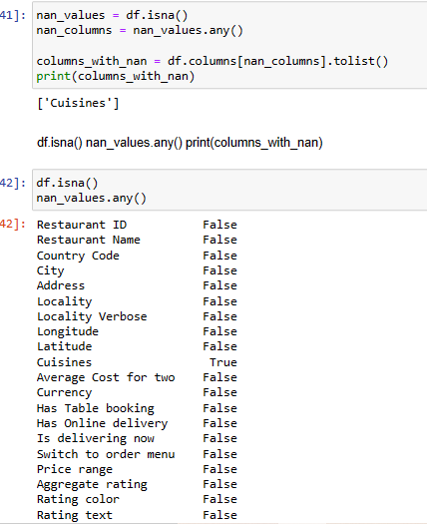
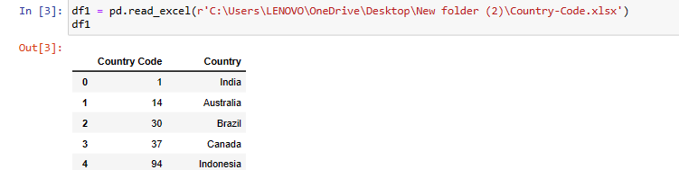
Data Cleaning
Checking if dataset contains any null values and have to clear it because it affect our data while analyzing…..
Cuisines seems to contain null values. Hence any further analysis involving Cuisines the NaN values has to be considered.
There is an other file which is also available along with this dataset .
We have to load that data as well
© All rights reserved by Fireblaze Technologies Pvt. Ltd.

Slide 7
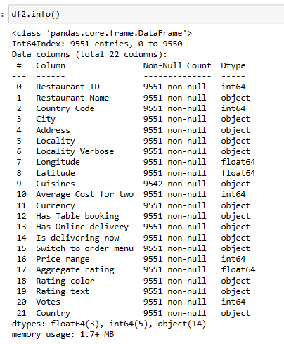
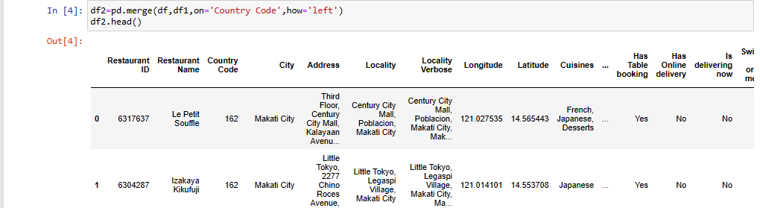
Merging of the Data
Let merge the both dataset this will help us to understand the data set country wise.
We can’t see columns properly so take the info of the whole data…and get knowledge about all columns…
This are all 21 columns which is further use in the data visualization…….
© All rights reserved by Fireblaze Technologies Pvt. Ltd.

Slide 8
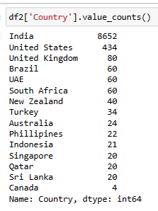
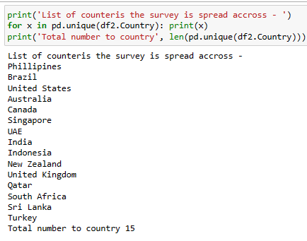
Brief Analysis and Data Visualization of Zomato Data
First up all, we have to get the whole restaurants data which is geographical spread , which help us to understand the rating,
Currency , Online Delivery , City Coverage ....and many more... This is the value count of the Country wise data….
List of countries the survey is spread across
The survey seems to have spread across 15 countries all over world.
This shows that Zomato is a multinational company having actives business in all those countries.
© All rights reserved by Fireblaze Technologies Pvt. Ltd.

Slide 9
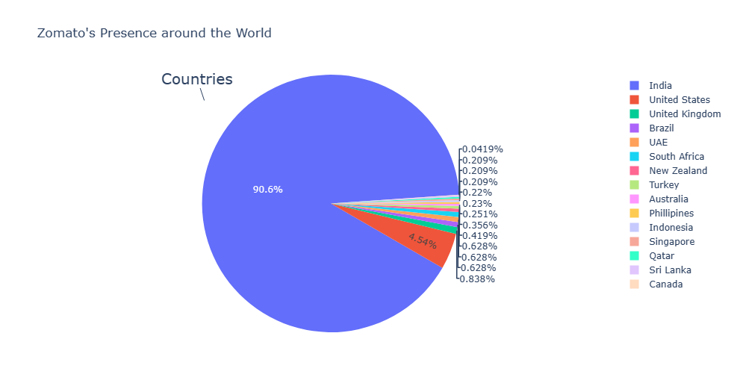
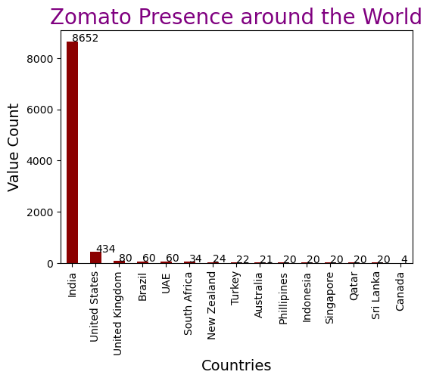
Descriptive Analysis
As Zomato is a startup from India hence it makes sense that it has maximum
business spread across restaurants in India
This Data show same information…India is in majority….
© All rights reserved by Fireblaze Technologies Pvt. Ltd.

Slide 10
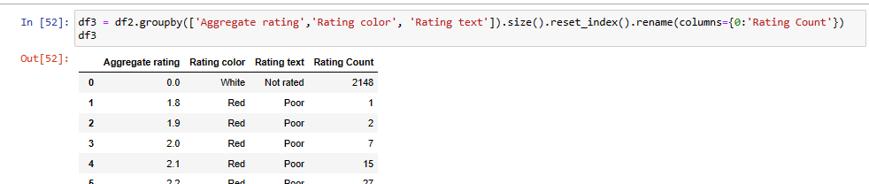
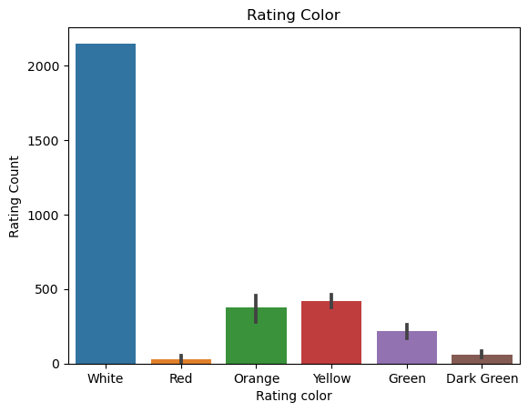
Descriptive Analysis
Understanding the Rating aggregate, color and text:
The above information helps us to understand the relation between Aggregate rating,
color and text. We conclude the following color assigned to the ratings:
Rating 0 — White — Not rated
Rating 1.8 to 2.4 — Red — Poor
Rating 2.5 to 3.4 — Orange — Average
Rating 3.5 to 3.9 — Yellow — Good
Rating 4.0 to 4.4 — Green — Very Good
Rating 4.5 to 4.9 — Dark Green — Excellent
Let us try to understand the spread of rating across restaurants
Interesting, Maximum restaurants seems to have gone No ratings.
© All rights reserved by Fireblaze Technologies Pvt. Ltd.

Slide 11
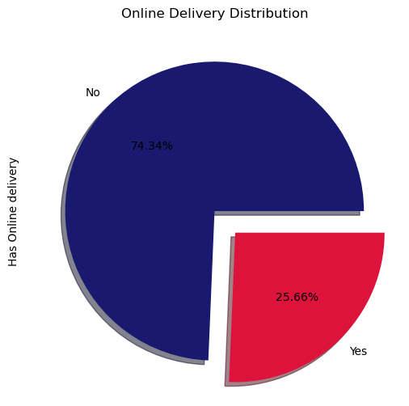
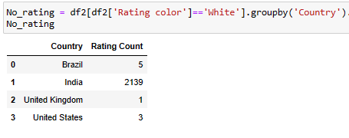
Descriptive Analysis
Let us check if these restaurants belong to some specific country
India seems to have maximum unrated restaurants.
In India the culture of ordering online food is still gaining momentum hence most
of the restaurants are still unrated on Zomato as people might be preferring to visiting the restaurant for a meal..
Only 25% of restaurants accepts online delivery. This data might be biased as we have maximum restaurants listed here are from India. Maybe analysis over city wise would be more helpful.
© All rights reserved by Fireblaze Technologies Pvt. Ltd.

Slide 12
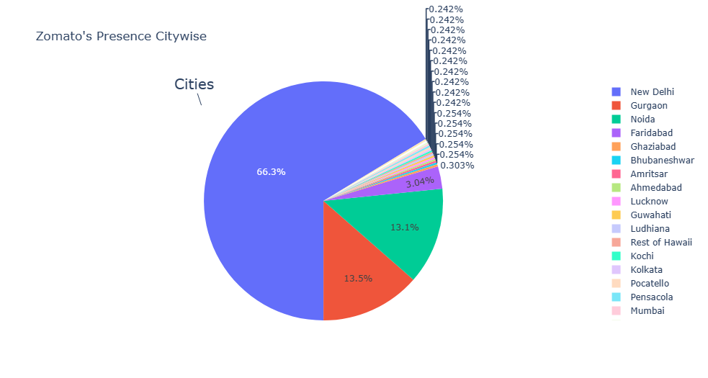
Descriptive Analysis
Let us try to understand the coverage of city
The data seems to be skewed towards New Delhi, Gurgaon and Noida. I see minimal data for other cities.
Hence I would do my analysis predominantly on New Delhi.
We’ve already gained several insights about the restaurants present in the survey.
Let us try some visualization and operation using this data....to get more information...about the restaurants...
© All rights reserved by Fireblaze Technologies Pvt. Ltd.

Slide 13
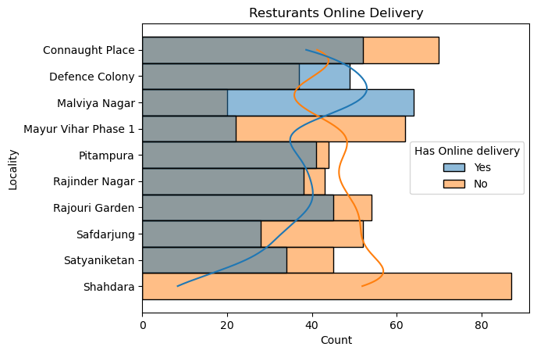
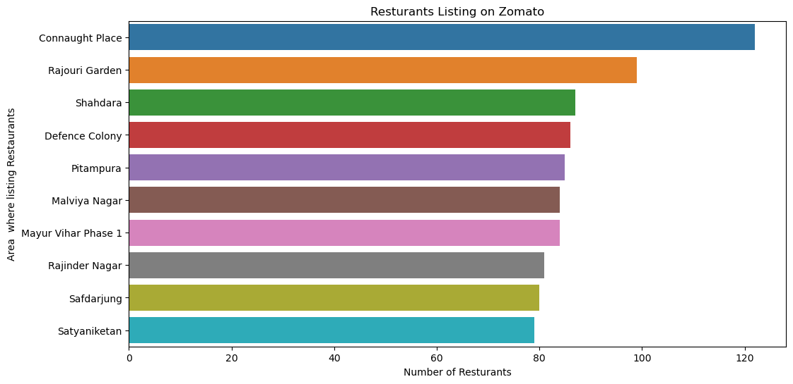
Descriptive Analysis
Lets us try some experiment how the Zomato is being spread throughout the different section..... In Delhi high rated restaurant except online delivery or not…..
Locality having maximum hotels are listed in Zomato
Connaught place seems to have high no of restaurants registered with Zomato,
Online Delivery is high in Defence Colony and Malviya nagar whereas
Shahdara don’t except the online delivery
© All rights reserved by Fireblaze Technologies Pvt. Ltd.

Slide 14
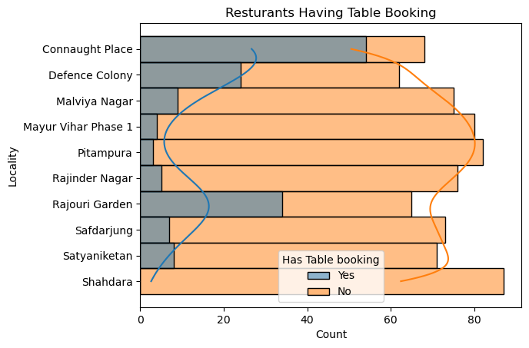
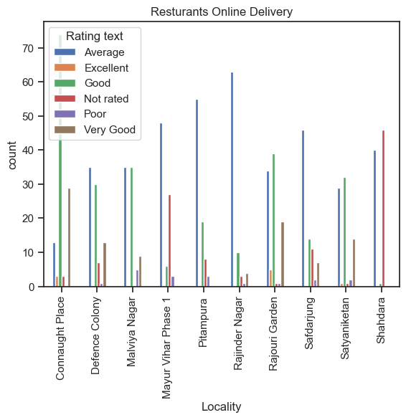
Descriptive Analysis
Lets us understand the Restaurants Rating localities.. Restaurant Having Table Booking or Not
I would now like to understand the rating of these restaurants that
are providing online delivery .
© All rights reserved by Fireblaze Technologies Pvt. Ltd.

Slide 15
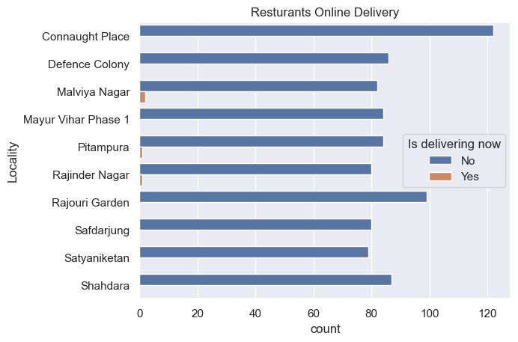
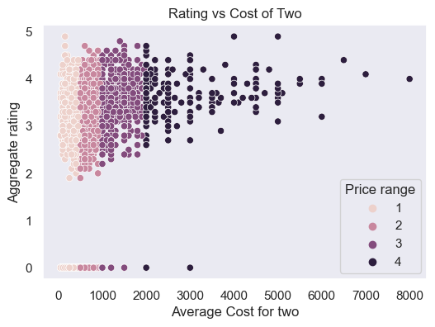
Descriptive Analysis
Restaurant Is Delivering Now Let us understand the cost of Dinning vs their Aggregate Rating
I observe there is no linear relation between price and rating. For instance, Restaurants with good rating (like 4–5) have restaurants with all the price range and spread across the entire X axis
© All rights reserved by Fireblaze Technologies Pvt. Ltd.

Slide 16
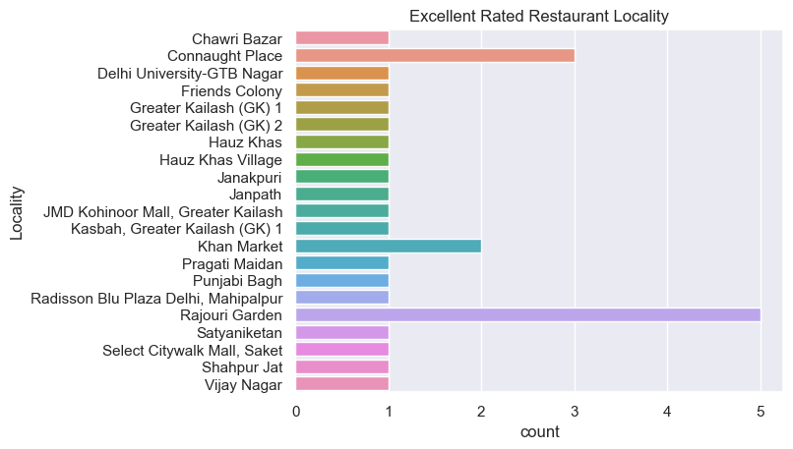
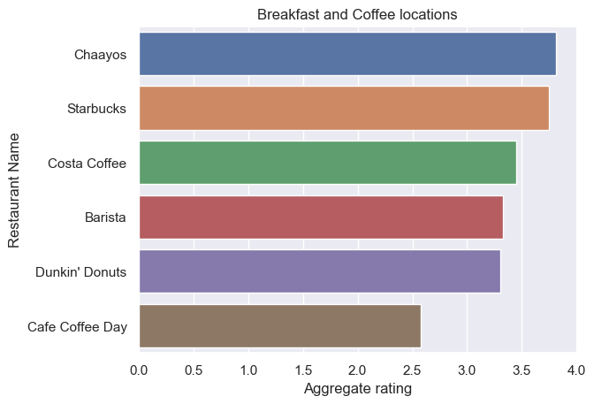
Descriptive Analysis
Location of Highly rated restaurants across New Delhi Common Eateries
Breakfast and Coffee locations
The aforementioned four cities represent nearly 65% of the total data available in the dataset. Apart from the higly rated local restaurants, it’d be intersting to know where the known-eateries that are commonplace. The verticles across which these can be located are -
Breakfast
American Fast Food
Ice Creams, Shakes & Desserts
© All rights reserved by Fireblaze Technologies Pvt. Ltd.

Slide 17
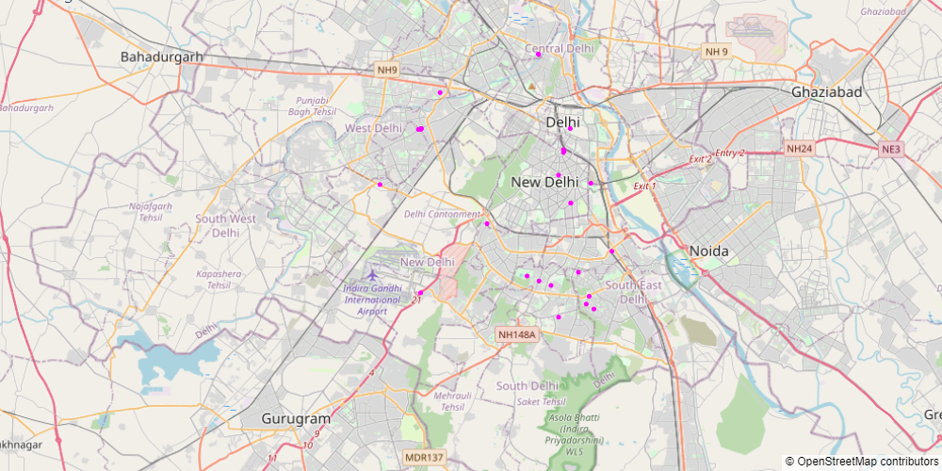
Descriptive Analysis
Location of Highly rated restaurants across New Delhi …We can see visually by using map....
© All rights reserved by Fireblaze Technologies Pvt. Ltd.

Slide 18
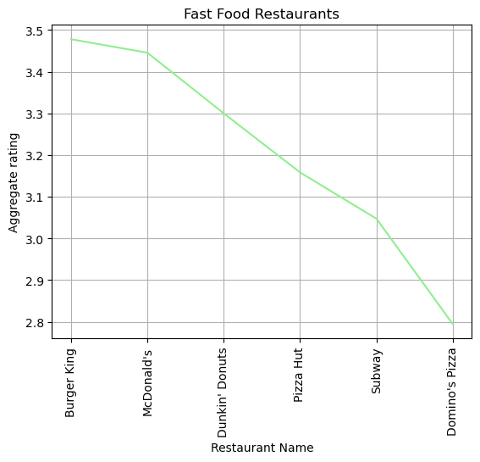
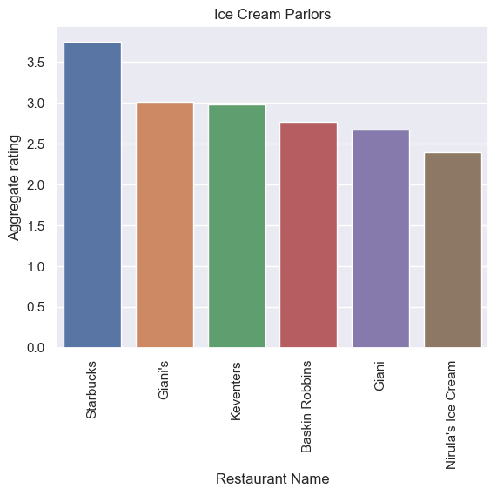
Descriptive Analysis
Fast Food Restaurants Ice Cream Parlour
© All rights reserved by Fireblaze Technologies Pvt. Ltd.

Slide 19
Conclusion
We’ve drawn many inferences from the survey. Here’s a summary of a few of them:
The dataset is skewed towards India and doesn't represent the complete data of restaurants worldwide.
Restaurants rating is categorized in categories
Not Rated
Average
Good
Very Good
Excellent
Connaught Palace have maximum restaurants listed on Zomato but in terms of online delivery acceptance Defence colony and Malviya nagar seems to be doing better.
The top rated restaurants seems to be getting better rating on the following cuisine
North Indian
Chinese
American
Italian
There is no relation between cost and rating. Some of the best rated restaurants are low on cost and vice versa.
On common Eateries, For Breakfast and Coffee location Indian restaurants seems to be better rated but for Fast food chain and Ice cream parlors American restaurants seems to be doing better.
© All rights reserved by Fireblaze Technologies Pvt. Ltd.

Slide 20
Future Scope
Future of Zomato in India......
As we all know Zomato is the Indian Company…And this data give Large information about India …So as Zomato is growing company its future is quite bright
It helps people to get food on doorsteps in this busy scheduled life
Here's why Zomato works well in these countries and it's hard for someone like Yelp to beat it: Cheap manual labor: The Zomato model needs a lot of paid manual labor. Countries with cheaper labor costs like India are the ones where Zomato has succeeded till now.
"Food has no religion" basic moto of Zomato”
First mover advantage – One of the best competitive advantages of Zomato is that it is the first mover in many of the nations where it is establishing itself. Directories and other forms of restaurant ratings might exist.
Convenience to use
Healthier Delivery Options
Coins has two sides.. we have to look both sides pros and cron …
Customers often back out from ordering their food after looking at the additional taxation and delivery charges. This practice becomes a disadvantage for this food delivery app
Killing the Vibe.
More Expensive
Isolated Disconnect.
Zomato has traveled a long way to become one of the success stories among Indian startups in 2021, with almost 50% share in the food delivery market.
© All rights reserved by Fireblaze Technologies Pvt. Ltd.

Slide 21
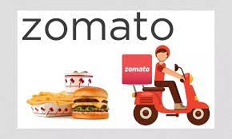
Your Food is Ready
© All rights reserved by Fireblaze Technologies Pvt. Ltd.

